Slide 1
Credit Risk Analysis
Anjali Jujare

Slide 2
Project Objective
To identify key risk indicators influencing loan default
To analyze customer behavioral patterns
To study loan eligibility and repayment patterns
To apply statistical methods for validation
To provide data-driven lending recommendations

Slide 3
Dataset Overview
Dataset contains applicant demographic and financial information
Target Variable: Loan Default
  0 = Non-Defaulter
  1 = Defaulter
Key Features:
  Income, Credit Amount, Annuity
  Age
  Housing Type, Occupation
  External Credit Scores

Slide 4
Data Cleaning & Feature Engineering
Missing values handled using median and mode imputation
Converted DAYS variables into YEARS:
  Age
  Employment
  Registration
Removed irrelevant and highly missing columns
Treated outliers using IQR method
Final cleaned dataset prepared for analysis

Slide 5
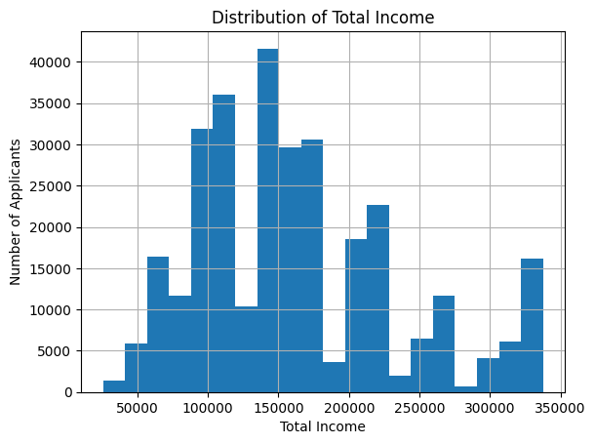
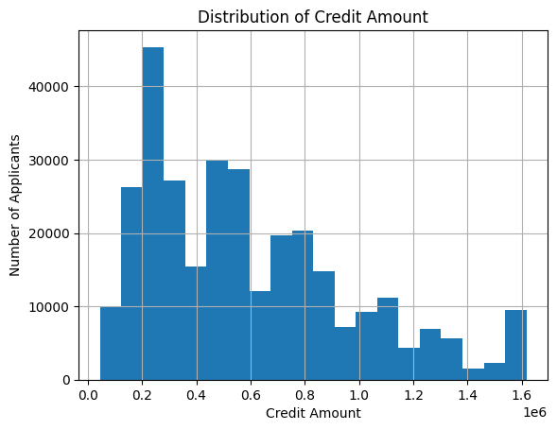
Univariate Analysis
Income
  As we can see the below graph is rightly skewed. We can analyse that most of the people’s income range from low to medium apply for credit card the most.
  Hence, we can say that most of the applicants belongs to the group of low to medium total income.
Credit amount
  As we can see the peak of bars is mostly on the left side, that means
  Most applicants take moderate credit amounts, while very high-value loans are less frequent

Slide 6
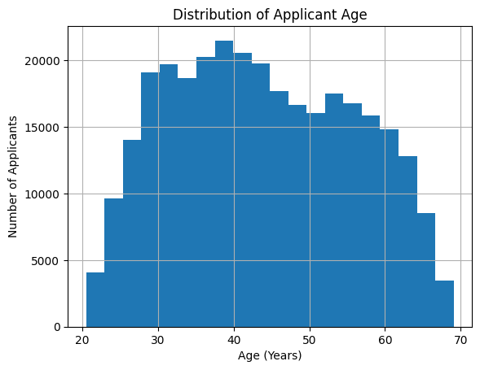
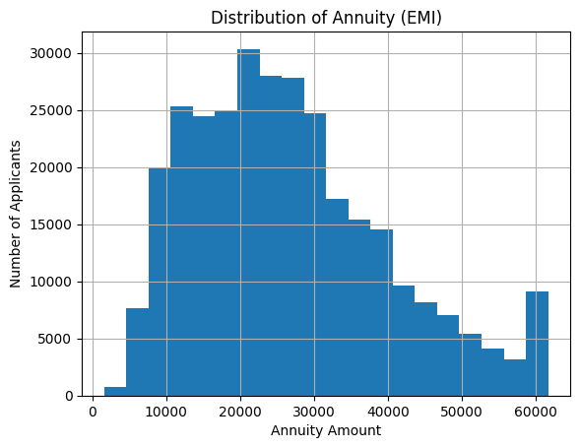
Univariate Analysis
Age
  As we can interpret from the below graph very few young age and old age people apply for loan.
  Most of the applicants belong to the working-age group (from 30 to 50)
Annuity
  The below graph shows how many people actually have monthly loan repayment
  Very few people have EMI above ₹50,000
  Most applicants have monthly EMI between ₹10,000 and ₹30,000.
  The highest concentration of applicants is around ₹15,000–₹25,000 EMI.
  Most people pay low to moderate EMI, and only a small number pay very high EMI.

Slide 7
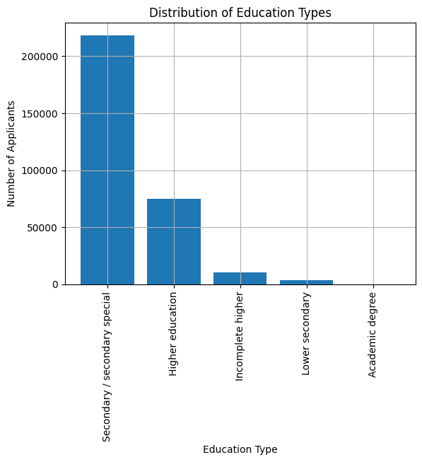
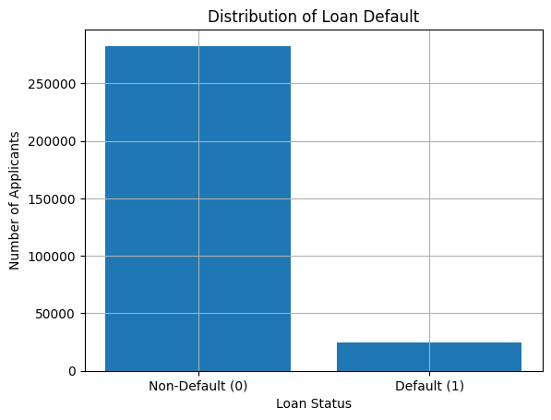
Univariate Analysis
Education
  Most applicants have “Secondary / secondary special” education.
  The second largest group is applicants with Higher education.
  Very few applicants belong to:
    Incomplete higher education
    Lower secondary
    Acaedemic Degree
Loan Default
  The number of Non-Defaulters (0) is much higher than the number of Defaulters (1).
  Most applicants repay their loans successfully.
  The bank’s overall loan performance is good, since most customers repay.
  The small defaulter group still causes major financial risk.

Slide 8
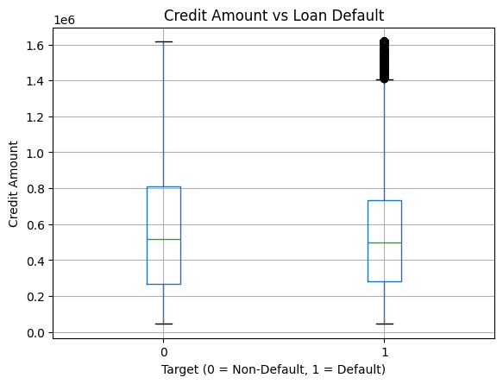
Bi-variate Analysis
CREDIT AMOUNT vs DEFAULT
Credit amount alone does not clearly separate defaulters
Defaulters & non-defaulters borrow similar loan amounts
Risk increases when high credit combines with low income

Slide 9
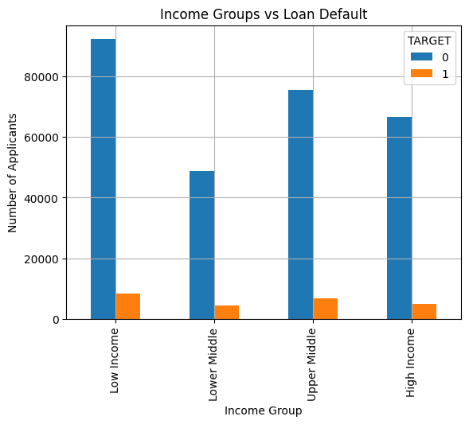
Bi-variate Analysis
INCOME GROUP vs DEFAULT
Low-income group has highest default
Default decreases as income increases
High-income group shows lowest risk
Income is a significant risk indicator

Slide 10
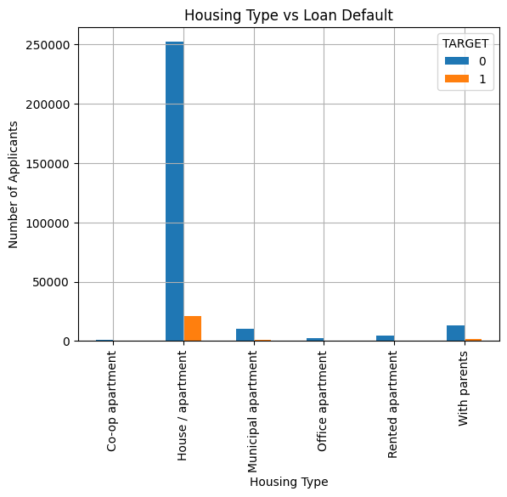
Bi-variate Analysis
HOUSING TYPE vs DEFAULT
Highest volume: House / Apartment
Higher risk observed in:
  Rented houses
  Living with parents
  Municipal housing
Home ownership indicates higher financial stability

Slide 11
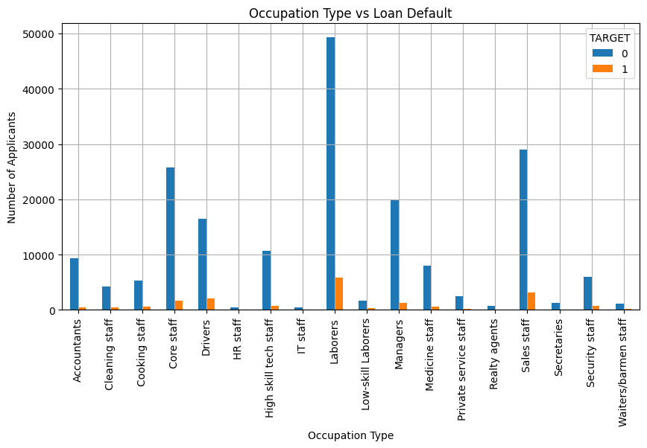
Bi-variate Analysis
OCCUPATION vs DEFAULT
Higher default observed in:
  Laborer
  Sales staff
  Drivers
Lower default observed in:
  IT professionals
  Managers
  High-skill technical staff
Occupation acts as a proxy for income stability

Slide 12
Hypothesis Testing Summary
Income vs Default → Significant (p < 0.05)
Gender vs Default → Significant
Education vs Default → Significant
Company vs Industry Default Rate → Higher than benchmark
External Scores vs Default → Highly Significant

Slide 13
Key Risk Indicators
Low External Credit Scores
High EMI to Income Ratio
Low Income Levels
Unstable Occupation
Risky Housing Conditions
Younger Age with Low Work Experience

Slide 14
Loan Eligibility Criteria
High income + high external score → Low risk
Low income + low score → High risk
Stable employment → Better eligibility
Rented housing + high EMI → Risky eligibility

Slide 15
Business Recommendation
Use external scores as primary screening filter
Maintain EMI ≤ 40% of monthly income
Apply risk-based loan pricing
Limit high-risk loan exposure
Prefer stable jobs & owned housing

Slide 16
THANK YOU

